Slide 1

Data mining
Data warehousing

Slide 2
BASIC IDEA OF DATA MINNING AND WAREHOUSING
A data warehousing create a centralized and organized database for efficient querying and reporting, and data mining digs deep into these data sets to uncover hidden patterns and valuable insights
Importance of these in modern day environments are listed below:
Data interpretation: consolidates data from multiple sources for unified view of business operation.
Historical analysis: Enables trend analysis and timely information to support tracking over time.
Customer insights: identifies pattern in customer behavior to improve marketing strategies.
Predictive analysis: Forecasts future trends such as sales or market changes.

Slide 3
Data warehousing
Data warehousing is the process of compiling information into a data warehouse. A data warehouse is designed to support the management decision making process by providing a platform for data cleaning, data integration and data consolidation.
Key feature of Data warehousing are :
-Data integration :refers to combing multiple data into a unified format
-historical Data storage:meaning it stores long term data for trend analysis.
-Non volatile:data is stable and not frequently modified once stored.

Slide 4
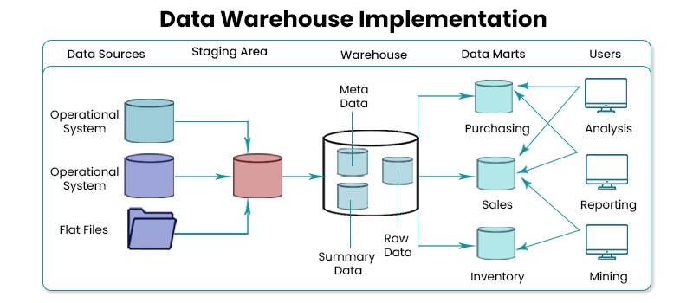
Components of data warehousing are:
1.Data Sources: These are the original systems or applications where data is created or stored
2. ELT Process (Extract, Load, Transform):
Extract: Data is pulled from source systems with minimal processing and stored in a staging area
Load: Raw data is loaded into the data warehouse, either incrementally or in bulk.
Transform: Data is cleaned, formatted, aggregated, and validated within the data warehouse.
3. Data Warehouse Storage: The core of the data warehouse is where transformed data is stored for long-term analysis. This storage structure includes:
4.Metadata: Metadata enables users to understand the structure of the data, and it’s useful for troubleshooting, auditing, and ensuring data quality.
5. Data Marts: Data marts are subsets of the data warehouse, typically focused on specific business areas.

Slide 5
Benefit of data warehousing
Data Understanding: A data warehouse simplifies corporate data for easier understanding.
Continuous Updates: It allows for frequent updates, helping businesses stay current.
Accessibility: It makes data more accessible to businesses and organizations.
Historical Analysis: It stores large volumes of historical data for trend analysis and future predictions.

Slide 6
3. Data mining
It is the process of finding patterns and correlations within large data sets to identify relationships between data
Key feature of data minning
-Data Cleaning- removes error ,inconsistencies, and redundant informationto ensure high quality data for mining
-Pattern discovery-identifies meaningful patterns trends or relationships.
-Data visualization-Presents mined data results in graphical format for easier interpretation.

Slide 7
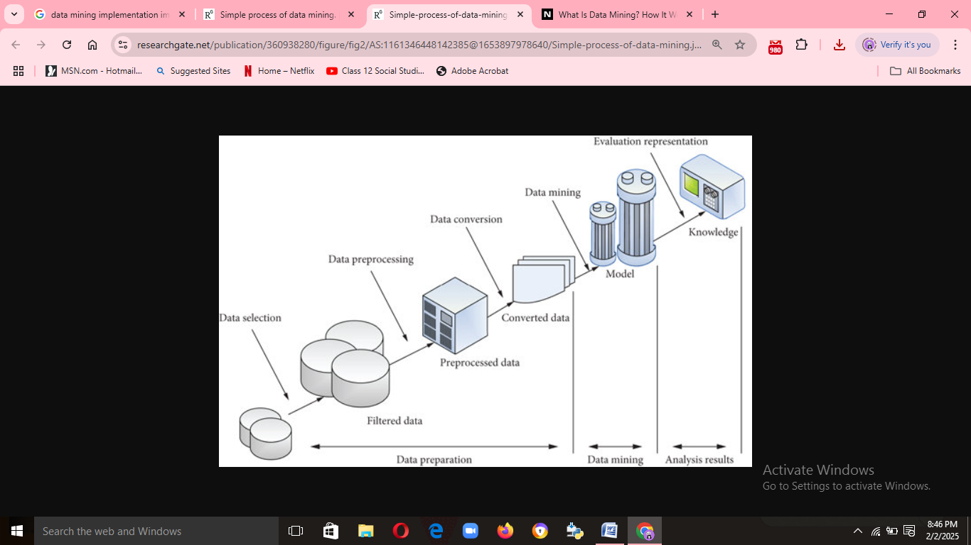
Process of data mining
Problem Definition: Define the goal or issue to address with data mining.
Data Collection: Gather data from various sources.
Data Preprocessing: Clean and prepare data by handling missing values and transformations
.Data Exploration: Use visualizations and statistics to find patterns.
Model Building: Apply mining techniques to uncover insights or make predictions
.Evaluation: Assess model accuracy and relevance.
Interpretation & Presentation: Present results to stakeholders with reports and visuals.
Deployment: Implement the model into real-world applications
.Monitoring & Maintenance: Regularly update the model to maintain accuracy.

Slide 8
5.Application
E-Commerce: it is used in e commerce for personalized recommendation
Banking :its used to detect fraud
Retail:walmart uses data warehousing and mining to analyze sales pattern and optimize supply chain
Health care: used to analyze patients data to prevent diseases outbreaks and optimize treatments.

